Slide 1

Truancy Prevention Measure Tribunal SCHOOL DATA & MARKETING

Slide 3
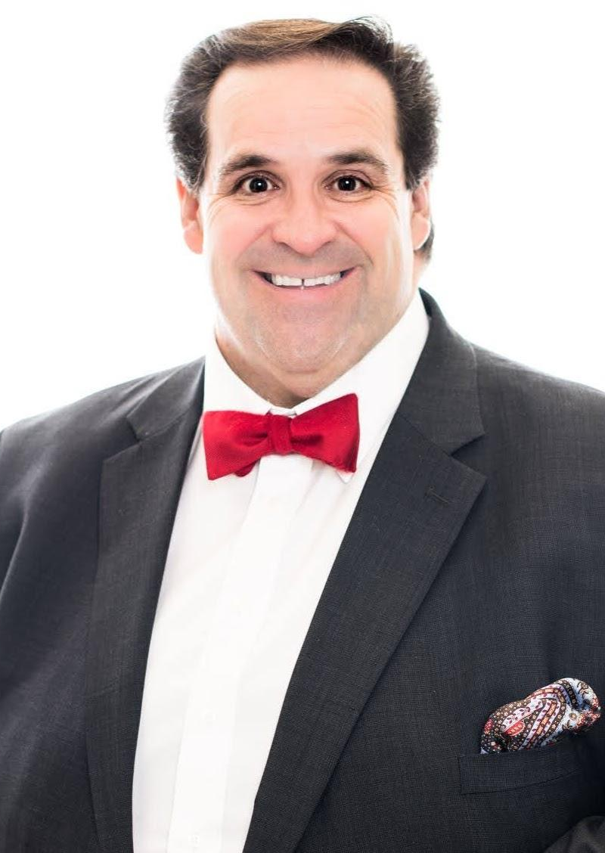
Judge John Payton (ret):
Judge Payton has a very unique story. After moving to Plano, Texas in 1989 he took a class called law major studies. Judge Payton learned you only had to be 18 years old to become a Justice of the Peace in Texas. Judge Payton got on the ballot and ran a door to door campaign against a 50 year old incumbent. Judge Payton was elected in 1990 the youngest “Judge” in the world, and is in the Guinness Book of World Records. He was elected at the age of 18 years old and was elected in 7 straight elections until he retired to open up Payton, Nix, & Associates December of 2018. Judge John Payton, President, Payton, Nix, & Assoc. LLC.
Judge Payton has made working with kids and families his lifetime legacy. Judge Payton created the Collin County Truancy Court and has presided over 98,000 student cases. Through innovative programs Judge Payton has a success rate of 98.8% with getting kids back home, off drugs, and graduated. Judge Payton has changed the culture in Collin County with how we address and help at-risk youth. Judge Payton created Students on Service (SOS) in 1995. Judge Payton created a community service program where he taught at-risk youth to see how doing good feels so much better doing things like building homes for Habitat for Humanity, created a food bank for families out of his court that the kids administered, and partnered with AllenISD to create a farm program teaching kids how to go from the farm to the table. Judge Payton created the Collin County Teen Court Program that has been in place for 28 years.

Slide 4
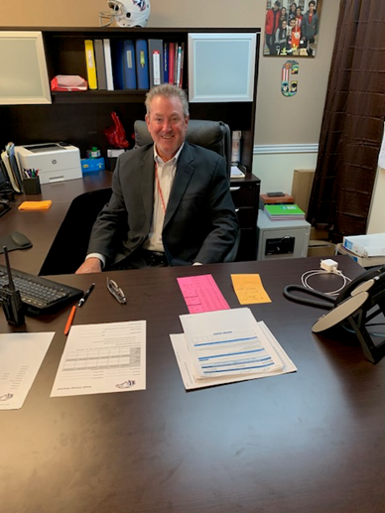
Dr. Charles Nix:
Dr. Charles Nix Vice-President Payton, Nix & Associates, LLC began his 38 years of service in public education at West Mesquite High School as a teacher, Assistant Principal and Principal from 1981 to 1997; Principal of Mesquite High School (’97-’04); Principal Rockwall-Heath High School 2004-2007; House Principal Allen High School (’07-’18).
This last year has been very exciting for Payton, Nix, & Associates. The Truancy Prevention Measures Tribunal came to life in January of 2019. Our program is based on developed processes and forms that were practiced and used in Judge Payton’s court. Based on those processes we partnered with Project Education and built a software that encapsulates 28 years of listening to suggestions from assistant principals, school counselors, teachers, and superintendents. The software and the process reveals all of the shadows in the corners so that nobody can hide and we can truly address the problem at hand. With the purchase of the program all of the forms and processes come with it. We have found that truancy is just a symptom of a bigger problem. Payton, Nix, & Associates LLC have found that digging deeper and providing resources can many times resolve the issue at hand.

Slide 5
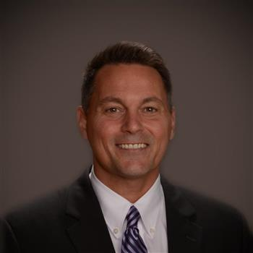

Dr. John Burdett is the Director of Student Services for Prosper ISD. Dr. Burdett brought Payton, Nix, & Associates, LLC. in to work with Prosper ISD November 2022. Payton, Nix, & Associates LLC, has held 9 Truancy Prevention Measure Tribunals and the data follows.

Slide 6
 | Number of Students | Number of Unexcused Absences | Number of Failed Classes | Number of Discipline Incidents
Original Hearing | 127 | 2727 | 168 | 241
Status Hearing | 127 | 713 | 90 | 40
Difference |  | -2014 | -78 | -201
% +/- |  | 74% decrease in Unexcused Absences | 47% decrease in Failed Classes | 83% decrease in Discipline Incidents
ADA funding due to decrease in UA |  | $106,742
Judge Payton and Dr. Nix,
After the Status Hearings from yesterday, our updated information is below detailing the positive impact of the Truancy Tribunal Hearings.

Slide 7
 | Number of Students | Number of Unexcused Absences | Number of Failed Classes | Number of Discipline Incidents
Original Hearing | 269 | 6249 | 168 | 604
Status Hearing | 269 | 1439 | 90 | 207
Difference |  | -4810 | -78 | -397
% +/- |  | 77% decrease in Unexcused Absences | 47% decrease in Failed Classes | 66% decrease in Discipline Incidents
ADA funding due to decrease in UA |  | $254,930 | Will collect final data after grades have been submitted.
I'll update final data for failed classes in a few weeks when grades update for the end of the year.

Slide 8
Judge Payton and Dr. Nix,
Attached are two PDFs that give the responses of Administrators and Parents, respectively, on the Truancy Tribunal Hearing Process. The responses are displayed as a pie chart.
I am also including two Excel Sheets where you can read the additional feedback that each group provided. The constructive/negative feedback from the Administrators is directed at what I can improve and not the actual Hearings so don't read into any of that.
Below is a synopsis of the percentage of Administrators and Parents who Strongly Agree/Agree to the question on their respective survey-good stuff!
Administrator Survey Data
The Daily Homework/Attendance Sheets help students to be more successful at school. | The students who attended the TTH improved their attendance. | The students who attended the TTH improved their grades. | The TTH is a vital part of helping students with attendance issues to improve their attendance and become successful. | The TTH reduced your workload and freed up time for you to focus on other components of your job. | I recommend the TTH to help improve student attendance and overall academic performance.
74% | 89% | 63% | 96.30% | 85.20% | 100%

Slide 9
Parent Survey Data
The TTH was better than going to Truancy Court and possibly receiving fines? | The TTH improved my child's attendance. | The TTH improved my child's grades. | Overall, I found the TTH to be successful for my child.
100% | 100% | 85% | 100%

Slide 10
FISD Truancy Tribunal Update
May 2021

Slide 11
As of April 30, 2021, 356 students attended a truancy tribunal.
Did students earn unexcused absences less frequently after attending a truancy tribunal?
Did students’ grades improve after attending a truancy tribunal?

Slide 12
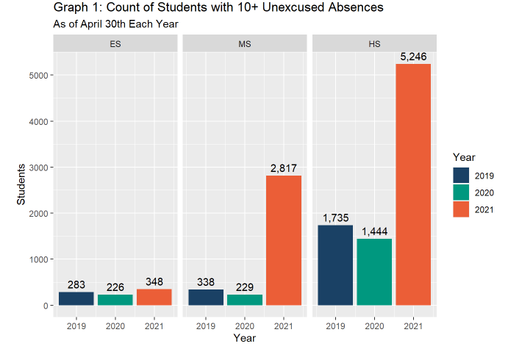
Problem: Increase in 10+ Unexcused Absences
Absences related to truancy and absences used to calculate funding (Average Daily Attendance) are measured in different ways. While our 10+ unexcused absences have risen this year, our overall attendance rate has actually improved.

Slide 13
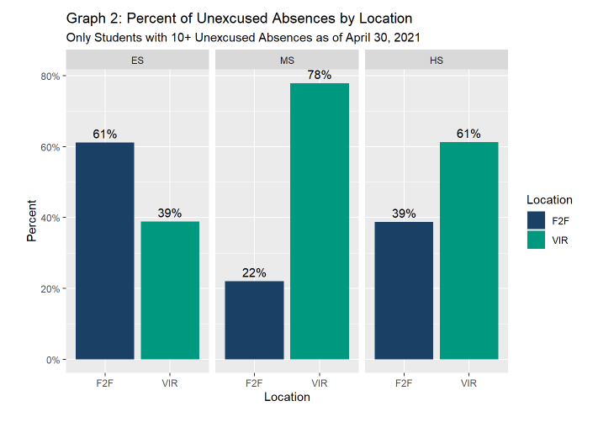
Face-to-Face and Virtual Students
An unexcused absence for any one period during a day counts towards a student’s 10 day truancy threshold. It’s possible that because it is easy to miss a Zoom call (accidentally or intentionally), the number of unexcused absences is much higher for virtual students than face-to-face students.

Slide 14
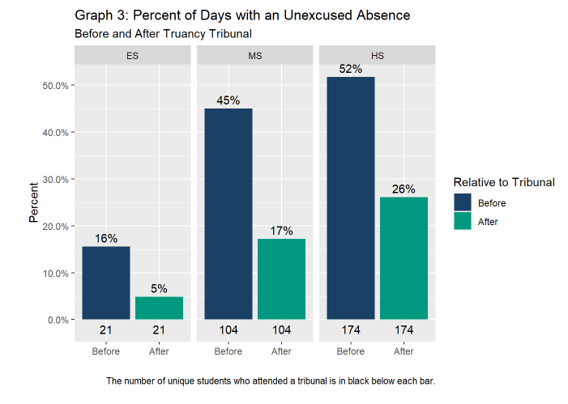
After attending a truancy tribunal, the rate of unexcused absences dropped significantly:
ES - dropped 11%
MS - dropped 28%
HS - dropped 26%

Slide 15
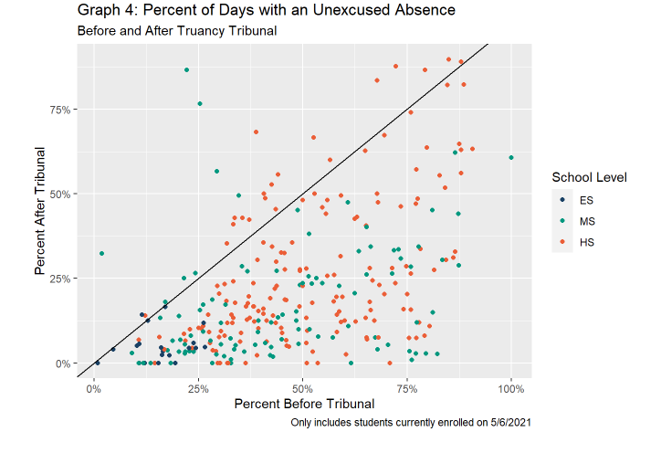
Percent of Days with an Unexcused Absence
X axis - unexcused absenteeism before the tribunal
Y axis - unexcused absenteeism after the tribunal
If there was not an effect, we would expect to see most of the dots on or near the diagonal line. Dots below and to the right indicate that the tribunal contributed to a reduction in the student’s absenteeism.

Slide 16
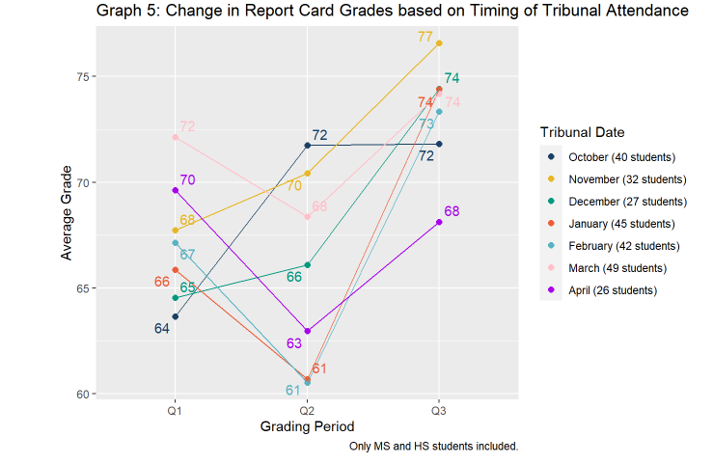
Change in Report Card Grades
Students who attended a tribunal early in Q2 (October) showed significant improvement on their Q2 grades while those who attended late in Q2 (November/December) showed less improvement.
Students who didn’t attend a tribunal until the Q3 marking period (January-March) had lower grades for Q2 but then suddenly showed drastic increases in grades for Q3.
These patterns suggest that the tribunal served as a turning point for students in both attendance and academic performance.

Slide 17
Additional Information
850+ hearings held for the 2020-21 school year, as some students required more than one status hearing.
We have filed truancy on thirteen (13) families for the 2020-21 school year, in comparison to eighty (80) cases for the 2019-2020 school year.
The average number of classes passed before tribunals is two (2), and after tribunals that increases to four plus (4+).

Slide 18
Additionally...
During the tribunals, we are able to identify non-academic issues and provide interventions and support in areas such as:
Mental Health
Substance Abuse
Family Counseling (referrals)
Parental Support

Slide 19
Conclusion
The truancy tribunal appears to effectively reduce the unexcused absenteeism among students and contribute to higher academic performance.

Slide 20

The following is a narrative created for Allen ISD, Robert Christian Director Safe and Secure
Schools. It should be noted that attendance and truancy are a year-to-year process, while
comparisons are natural, comparisons should be taken with caution.

Slide 21
School Year 21-22:
238 students/families were brought to tribunal and truancy prevention measure orders executed.
2777 students were ready for referral to tribunal.
415 students were no longer truant and 63 were provisional.
Revenue captured through Truancy Prevention measures, students who are no longer truant or
provisional for 21-22 is: $2,951,625.26
Cost associated with Payton Nix & Associates; LLC is $74,999 for 30 days service annually.
A net revenue gain over cost of $2,876,626.26

Slide 22

School Year 22-23:
391 students/families were brought to tribunal and truancy prevention measure orders executed.
1431 students were ready for referral to tribunal.
241 students are no longer truant and 44 are provisional.
Revenue captured through Truancy Prevention measures, students who are no longer truant or
provisional for 22-23 (86% of year completed) is: $1,746,281.62.
Cost associated with Payton Nix & Associates; LLC is $74,999 for 30 days of service annually.
A net revenue gain over cost of $1,671,282.62
A typical original hearing last 15 minutes and a status/follow-up
hearing 10 minutes. An average day is 8 hours with 40 families and the potential at 30 days
annually to see 1200.

Slide 31
Legacy Truancy Tribunal

Slide 32
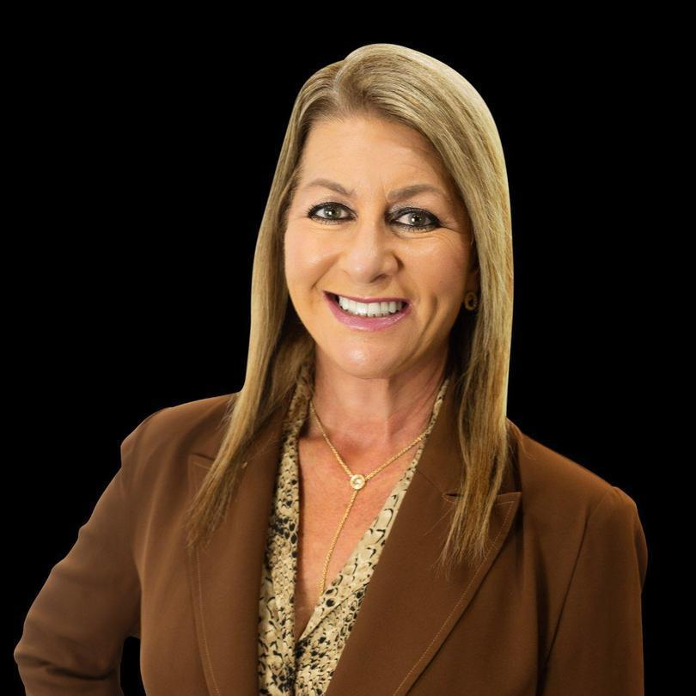

Staci Weaver is the Superintendent of Schools for the Legacy Preparatory Charter Academy. Mrs. Weaver brought Payton, Nix, & Associates in 4 years ago. Mrs. Weaver had Mrs. Acosta prepare the following data.

Slide 33
As of May 26, 2021, 205 students attended truancy tribunal.

Slide 34
Mesquite High School
190 students had 8 or more absences.
72 students attended truancy tribunal.

Slide 35
Mesquite High School

Slide 36
Mesquite High School

Slide 37
Mesquite High School

Slide 38
Mesquite Middle School
282 students had 8 or more absences.
44 students attended truancy tribunal.

Slide 39
Mesquite Middle School

Slide 40
Mesquite Middle School

Slide 41
Mesquite Middle School

Slide 42
Mesquite Elementary
80 students had 8 or more absences.
17 students attended truancy tribunal.

Slide 43
Mesquite Elementary

Slide 44
Mesquite Elementary

Slide 45
Mesquite Elementary

Slide 46
Plano
130 students had 8 or more absences.
75 students attended truancy tribunal.

Slide 47
Plano

Slide 48
Plano

Slide 49
Plano

Slide 50
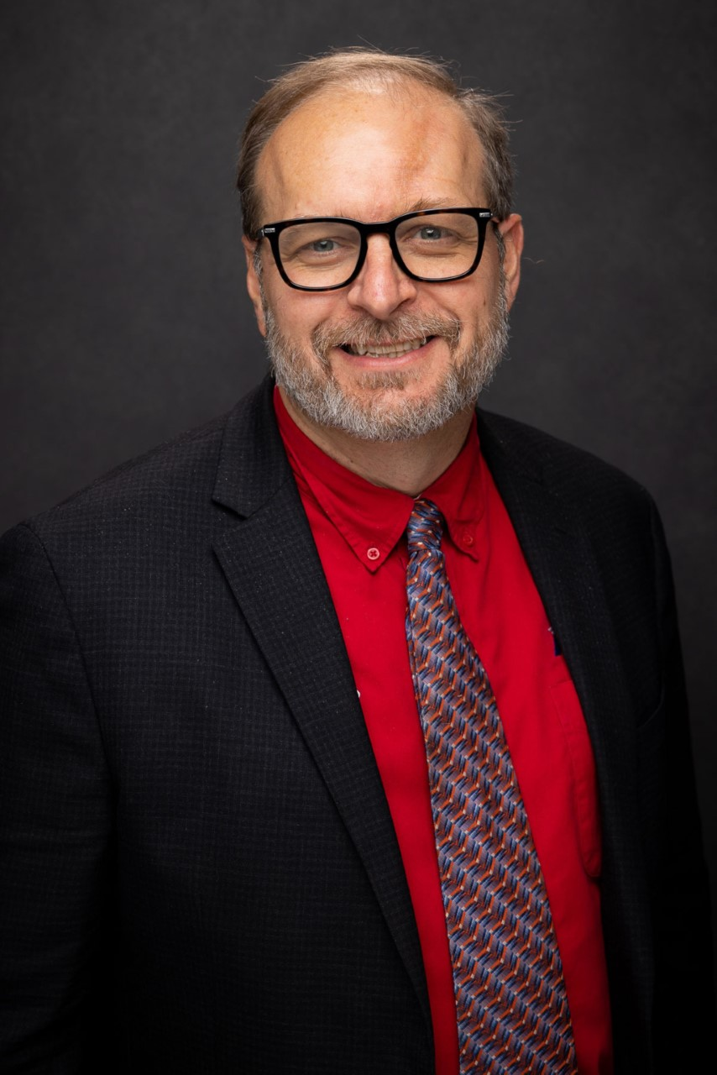
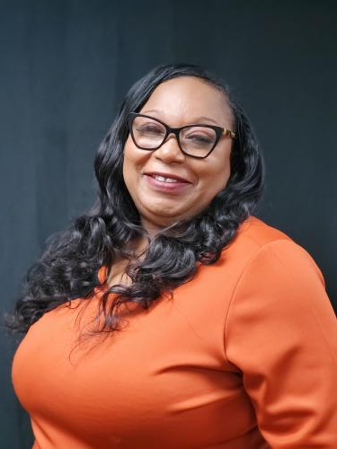
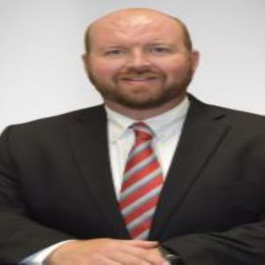

Dr. Brenton White , Superintendent of A+ Charter School Schools, Norman Lee M.E.d, Executive Director of Administrative & Student Services, and Yvette Dorty is the Director of Peims for A+ has partnered with Payton, Nix, & Associates LLC for a year and have worked very closely with the staff to get students back into school and on the right track. The data that follows was provided by A+ Charter Schools, Inc.

Slide 54
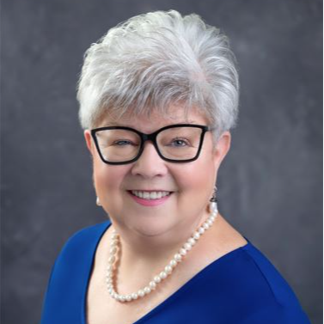

Rose Norman is the Executive Director of Enrollment &Recruitment for Southwest Charter Schools in Houston. Ms. Norman has been instrumental in the success of kids coming to school and being successful. Payton, Nix, & Associates LLC. Have worked with Ms. Norman for the last two years in the Truancy Prevention Measure Tribunal. The data that follows has been generated by Southwest Charter School staff.

Slide 56
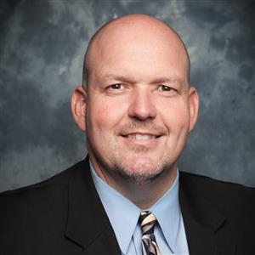

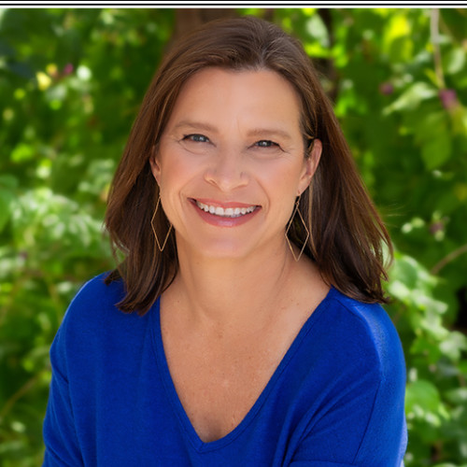
Dr. Tom O’Neal is the Deputy Superintendent for ShermanISD and Aileen Hays is the Coordinator for Counseling and Student Services. Through their leadership they have partnered with Payton, Nix, & Associates for the last two school years to keep students in school and improve their overall performance in school. The data presented here was created and provided by ShermanISD. A note needs to be added that with the increase of 2 plus percent the savings in ADA funding is 1.5 million dollars.

Slide 57
School | 2021-22 | 2022-23 |  | Improvement
SHS | 88.34 | 91.73 |  | 3.39
SMS | 90.47 | 92.56 |  | 2.09
Piner | 91.17 | 93.97 |  | 2.8
Jefferson | 62.07 | 76.11 |  | 14.04
Crutchfield | 92.25 | 94.22 |  | 1.97
Dillingham | 91.54 | 92.93 |  | 1.39
Fairview | 92.42 | 94.45 |  | 2.03
Neblett | 91.35 | 93.68 |  | 2.33
Sory | 92.44 | 95.05 |  | 2.61
Wakefield | 92.39 | 93.94 |  | 1.55
Washington | 92.45 | 94.22 |  | 1.77
I wanted to share with you guys some data that I've pulled together. I ran ADA reports for the past 2 years. The dates I used were August 18-May 1 of each year. I believe that this is the combination of the Project Truancy software, the secretaries' efforts, the APs efforts, and the tribunal program. I'm pretty happy with the results and I believe we can have even better results with some tweaks for next year.

